Slide 1

KNOWLEDGE INSTITUTE OF TECHNOLOGY AQUATIC INSIGHTS: COGNOS -POWERED WATER PORTABILITY ANALYSIS DATA ANALYTICS
MENTOR NAME : Mr.J.Murugesan, AP / IT
TEAM ID: NM2023TMID01874
TEAM:
MUGIL VENDHAN G (611220104090)
POMMI SUJITHA E (611220104104)
PREETHI M (611220104109)
PRINCY M (611220104110)

Slide 2
OBJECTIVE
To analyses the “AQUATIC INSIGHTS: COGNOS -POWERED WATER PORTABILITY ANALYSIS” using IBM Cognos.

Slide 3
ABSTRACT
"Aquatic Insights" utilizes Cognos-powered data analysis to assess water portability. This abstract highlights its innovative approach to comprehensively study water quality, availability, and distribution. The research aims to enhance our understanding of aquatic ecosystems and improve water resource management through advanced analytics, providing valuable insights into the sustainability of water sources and their impact on the environment.
This research offers a multifaceted examination of water systems, assessing factors such as quality, access, and transport. By leveraging advanced data analysis, this study seeks to elevate our comprehension of aquatic environments and elevate water resource management strategies. The outcomes promise to drive sustainable water source utilization while considering environmental implications.

Slide 4
PROBLEM STATEMENT
"Develop an analytics solution using IBM Cognos to assess and improve water portability. Analyze data related to water quality, supply, and infrastructure, identifying bottlenecks, vulnerabilities, and optimization opportunities. Deliver actionable insights and recommendations for efficient, safe, and sustainable water distribution, ensuring access to clean water for all.”
This project will study water quality, distribution, and infrastructure data, revealing issues and optimization opportunities. The objective is to provide practical recommendations for more efficient, secure, and sustainable water distribution. The goal is to ensure clean water access for all communities.

Slide 5
SOLUTION
For "Aquatic Insights," we propose a Cognos-powered solution for water portability analysis. This system leverages IBM Cognos analytics to provide real-time data visualization and reporting. It monitors water quality, availability, and distribution to ensure safe and efficient water access. Cognos analytics help optimize resource allocation and decision-making, ensuring reliable water supply for all.
Our comprehensive solution for "Aquatic Insights" integrates IBM Cognos analytics to enable data-driven water portability analysis. It harnesses real-time data for monitoring water quality, availability, and distribution, facilitating informed decision-making to optimize resource allocation and ensure equitable, safe, and efficient water access.

Slide 6
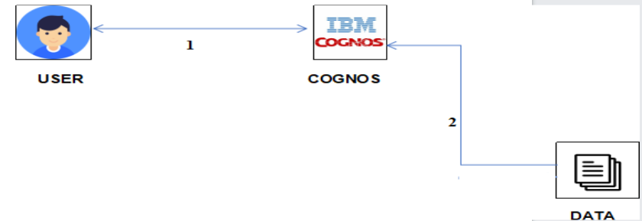
SOLUTION ARCHITECTURE

Slide 7
TOOLS USED
HARDWARE REQUIREMENS
Processor : Intel Core i3
RAM : 8 GB
Hard Disk : 500 GB
SOFTWARE REQUIREMENTS
Operating System : Windows
Language : HTML, CSS, JavaScript, Python
Program – Tool : Visual Studio Code
Web Framework : Flask
TOOL REQUIREMENTS
Operating System : Windows 10
Disk Space : 256 MB
Processor : Intel atom processor
Version : 3.6.2

Slide 8
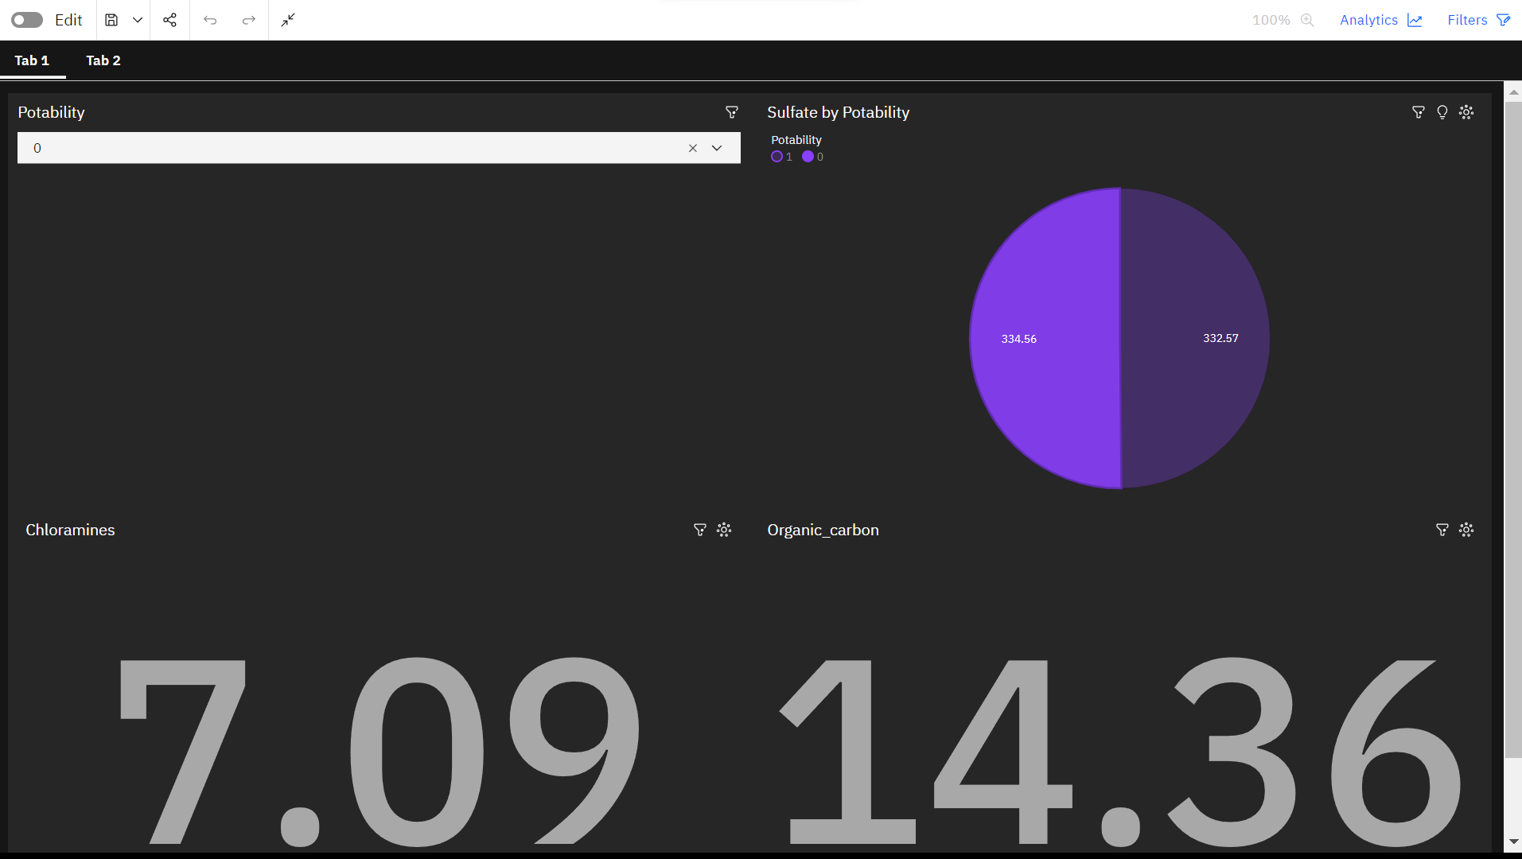
DASHBOARD

Slide 9
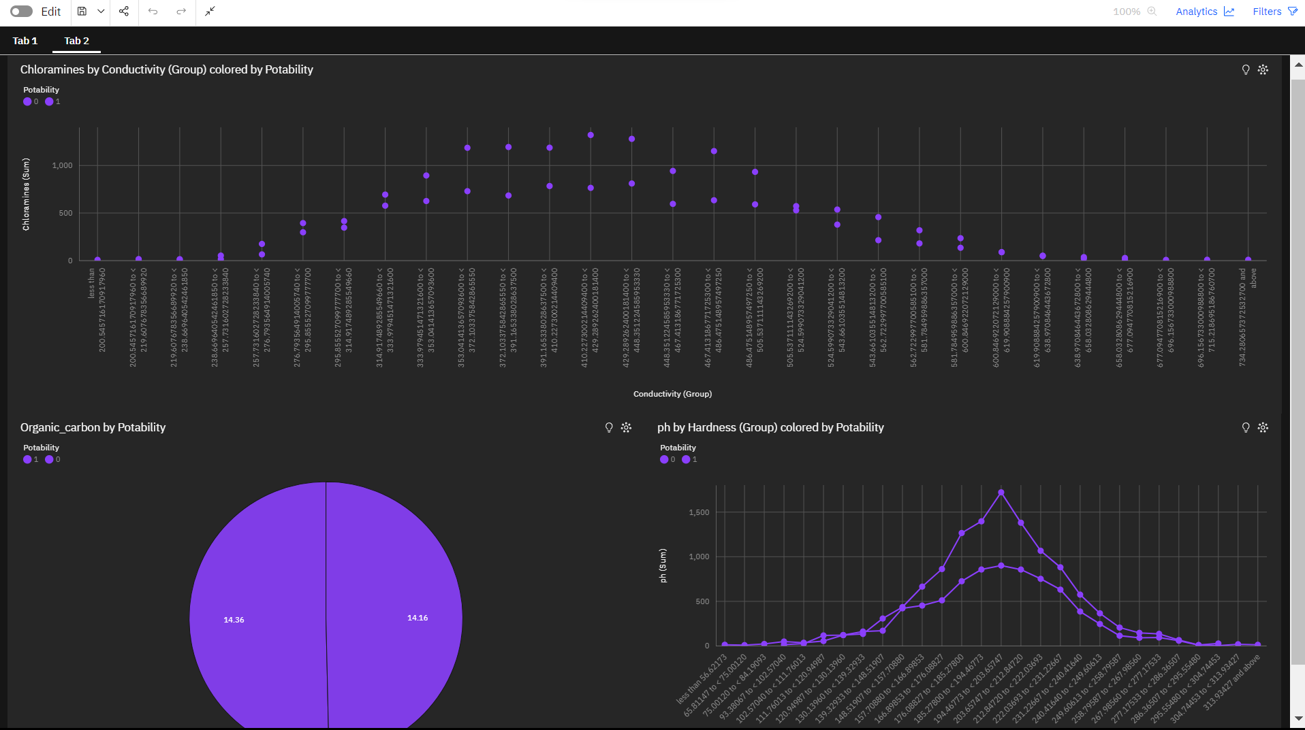
DASHBOARD

Slide 10
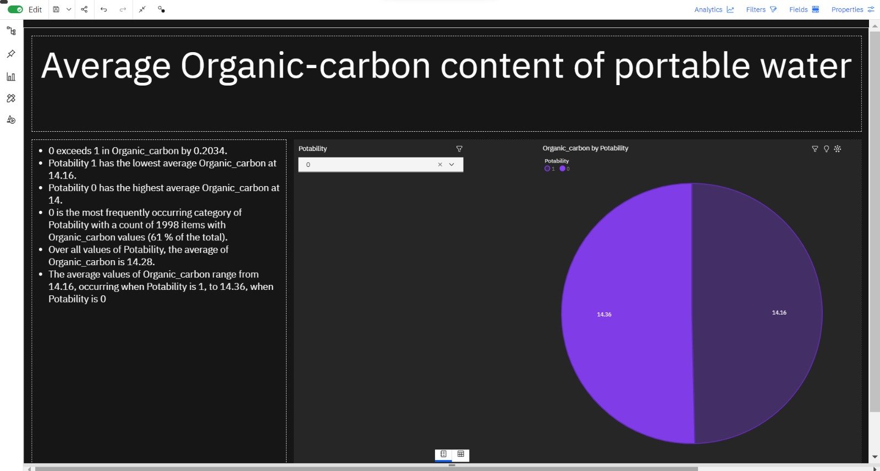
STORY

Slide 11
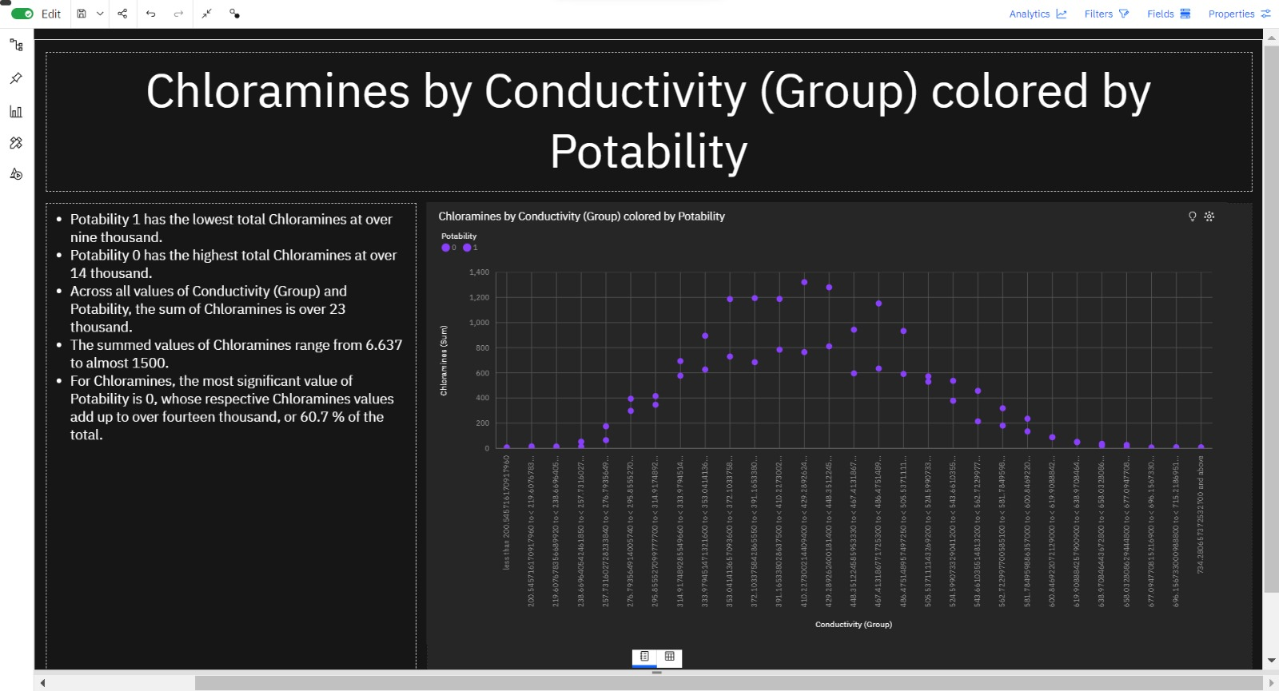
STORY

Slide 12
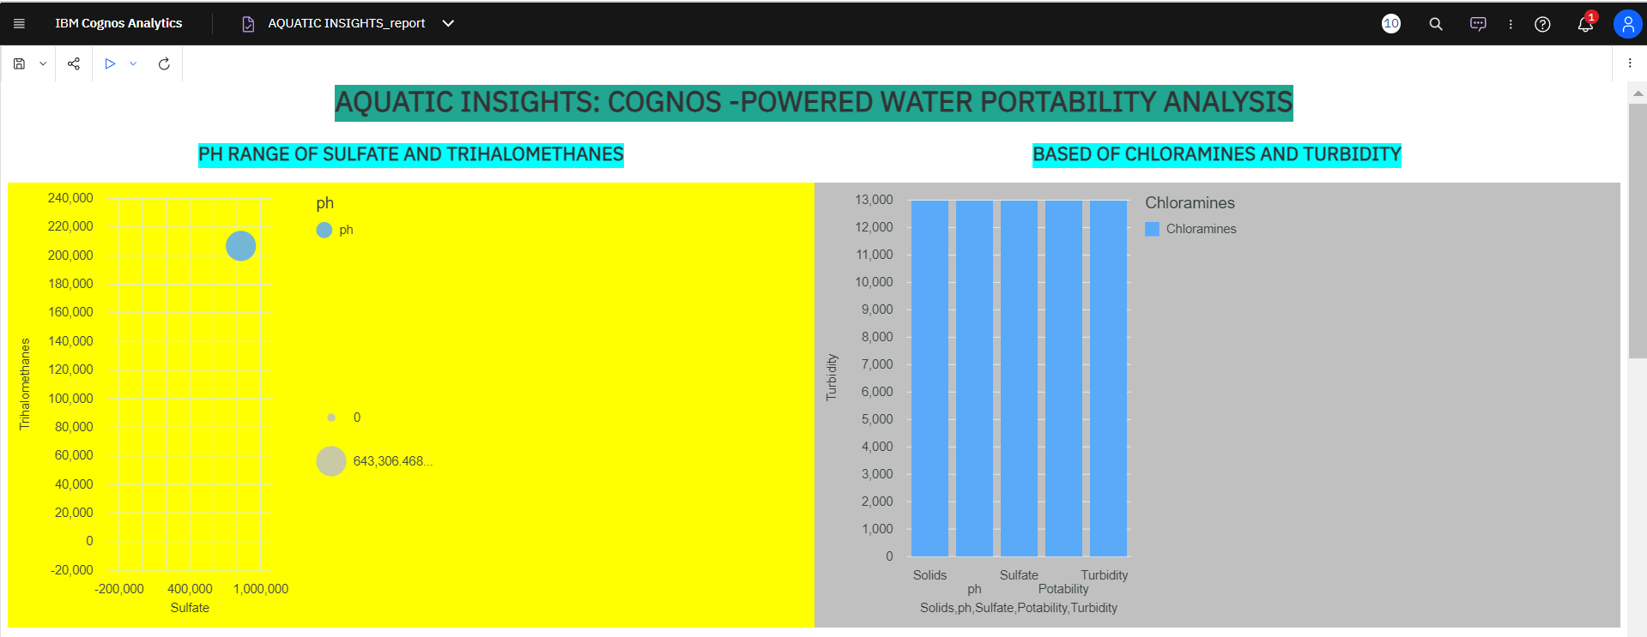
REPORT

Slide 13
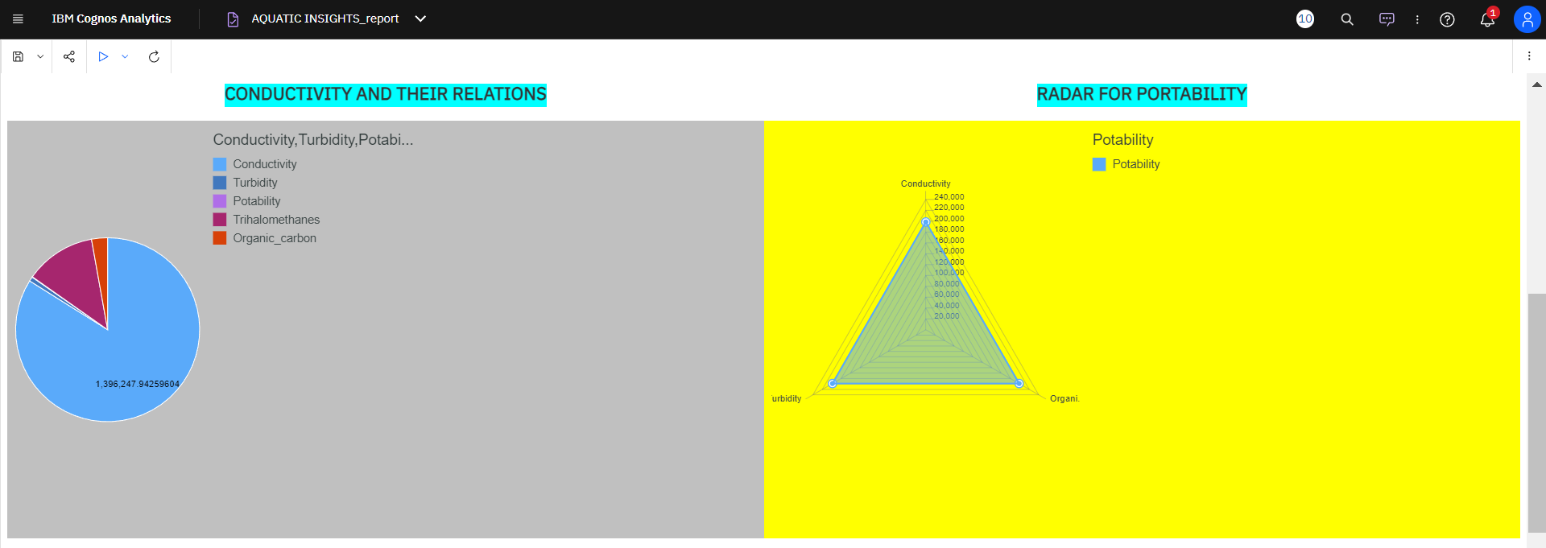
REPORT

Slide 14
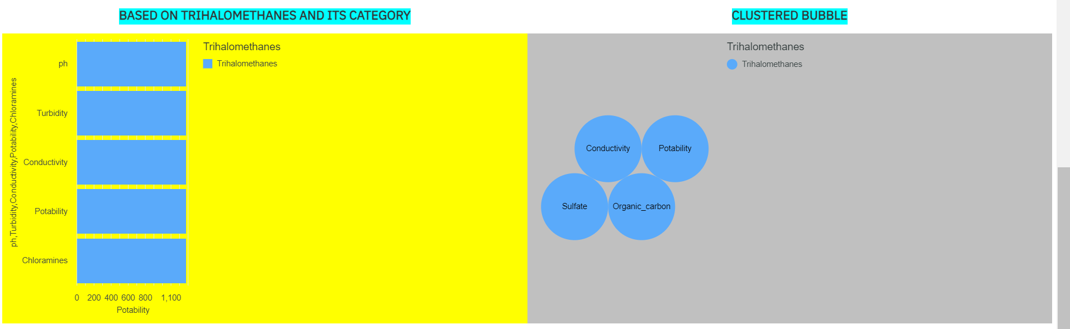
REPORT

Slide 15
THANK YOU

